Slide 1

Site-to-Site VPNs: Bridging On-Premises and Cloud Environments

Slide 2

What is a Site-to-Site VPN?
A site-to-site VPN is a secure tunnel that encrypts data traffic between two separate networks.
It uses industry-standard protocols like IPSec and IKEv2 to ensure data confidentiality and integrity.
Site-to-site VPNs can be used to connect on-premises
networks to cloud platforms like AWS, Azure, and
Google Cloud.

Slide 3
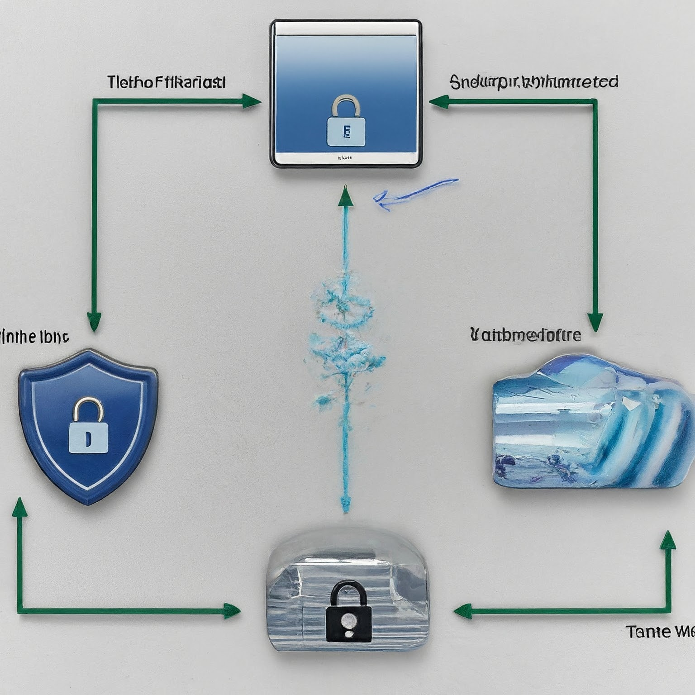
How Does a Site-to-Site VPN Work?
A site-to-site VPN typically involves the following components:
On-premises VPN device: This device is located at our on-premises network and manages the VPN connection.
Cloud VPN gateway: This is a virtual appliance provided by a cloud provider that handles the VPN connection on the cloud side.
Encrypted tunnel: The VPN creates a secure tunnel over the
internet, encrypting all data traffic that passes through it.
Public IP address: Both the on-premises VPN device and the
cloud VPN gateway needs public IP addresses to establish the
connection.

Slide 4
Components of Site-to-Site VPN
On-Premises Network Components:
Routers/Firewalls: Manage network traffic and enforce security policies.
VPN Gateway: Establishes and manages the VPN tunnel.
Cloud Network Components:
Virtual Private Gateway

Slide 5

Making a Site-to-Site VPN Connection
The specific steps for creating a site-to-site VPN will vary depending on the cloud provider and on-premises VPN device.
However, the general process typically involves the following steps:
Configure your on-premises VPN device.
Configure your cloud VPN gateway.
Establish the VPN connection.
Verify the connection and troubleshoot any
issues.

Slide 6
1. Planning & Design:
Assess network requirements:
Bandwidth: Analyze expected data traffic volume and identify peak usage periods.
Security policies: Define encryption standards, authentication protocols, and access control rules.
Compatibility: Ensure compatibility between on-premises devices and cloud environment.
Design VPN architecture:
Choose deployment topology (hub-and-spoke, full mesh).
Define redundancy options for high availability.
Select appropriate VPN devices and configurations.

Slide 7
2. Configuration:
On-premises VPN gateway/router:
Configure tunnel endpoints, encryption settings, and authentication methods.
Define routing policies for directing traffic through the VPN tunnel.
Cloud VPG:
Configure tunnel settings on the cloud side, matching on-premises configurations.
Set up routing and security policies as per cloud provider's guidelines.

Slide 8
3. Testing & Troubleshooting:
Conduct thorough testing:
Verify tunnel establishment and data transfer functionality.
Test performance metrics like latency and throughput.
Validate security features like encryption and authentication.
Troubleshoot any issues:
Analyze logs and identify connection errors or performance bottlenecks.
Adjust configuration settings based on troubleshooting findings.
Seek support from vendor or cloud provider if needed.

Slide 9

Benefits of Using a Site-to-Site VPN
Secure data transfer: Site-to-site VPNs encrypt data traffic, protecting it from unauthorized access.
Improved application access: Employees can securely access cloud-based applications from their on-premises devices.
Enhanced disaster recovery: Site-to-site VPNs can be used to replicate data to the cloud for disaster recovery purposes.
Increased scalability: Cloud resources can be easily scaled up or
down as needed, without impacting your on-premises network.
Cost savings: Site-to-site VPNs can help you reduce costs by
consolidating infrastructure and eliminating the need for dedicated
private lines.

Slide 10
Conclusion
Site-to-Site VPNs play a crucial role in securely connecting on-premises infrastructure to cloud environments.
By implementing robust security measures and optimization techniques, organizations can leverage Site-to-Site VPNs to achieve seamless integration and enhanced flexibility in their IT infrastructure.
As the demand for cloud services continues to grow, Site-to-Site VPNs will remain a vital component of modern network architecture.

